Slide 1
2023 Site Specific Plan Amendment Process Comments on CPN22-MA-006, Madison Acquisitions, LLC R-2 to PDH-4 at Gallows Road and Libeau Lane
Gerry Andrianopoulos
President
Raintree Homeowners Association

Slide 2
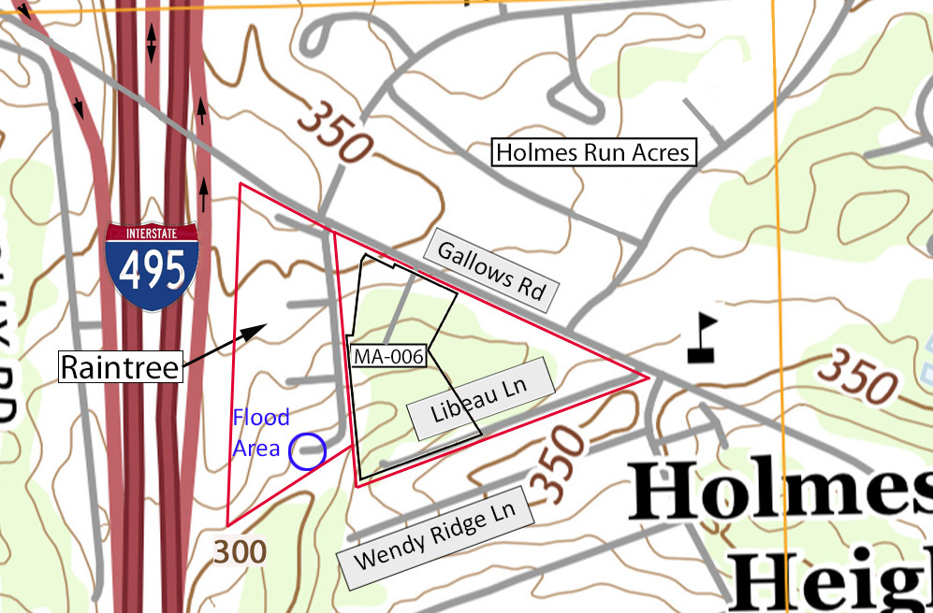
TOPOGRAPHY
On the North to South and East to West boundaries of MA-006 the elevation drops from 350 ft to 306 ft over a distance of 640 ft, a very steep slope.
20 homes of 3000-4000 sq ft with a two-car garage are incompatible with the topography short of massive regrading, tree loss and very high retaining walls.

Slide 3
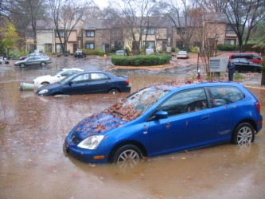
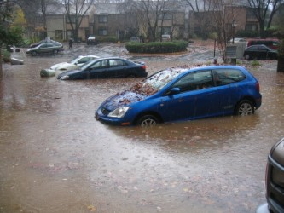
Storm Water Management
All of the runoff from MA-006 drains toward Raintree.
The county map labels the point at which this runoff reaches Raintree a “Flood Area.”
Raintree has flooded in the past.

Slide 4
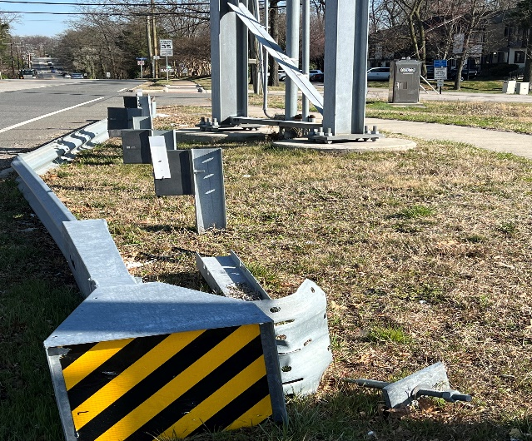
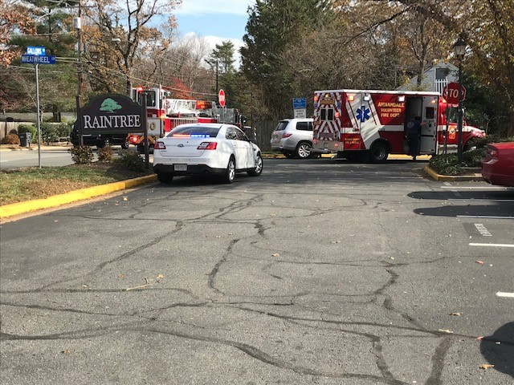
Traffic
Exiting and entering Raintree during heavy traffic is extremely dangerous.
Mile-long west-bound and east-bound traffic builds up between the traffic lights on the I-495 overpass and Annandale Rd.
Left turns out of Raintree are almost impossible, and Right turns are difficult due to continuous traffic from the left.
A single access road for 20 homes 300 ft east of Raintree would aggravate current traffic issues.

Slide 5
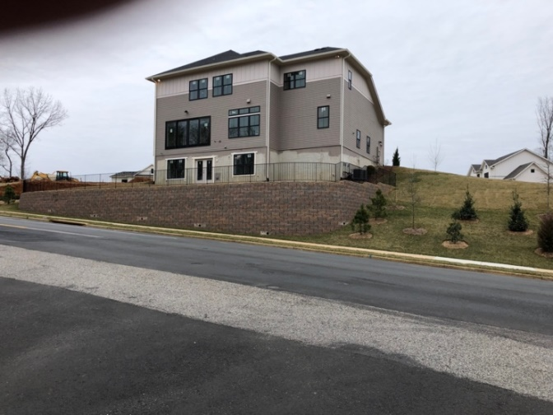
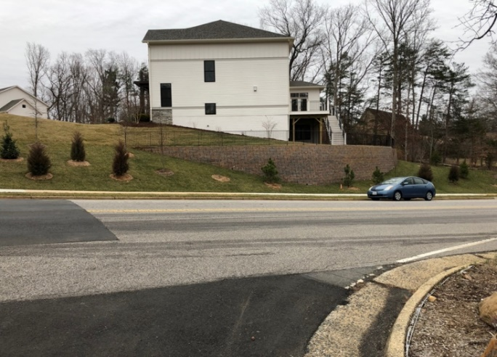
Scale of Development
Policy B of Objective 14 in the Policy Plan encourages “infill development in established areas that is compatible with existing …land use and that is at a compatible scale with the surrounding area.”
A development of large homes (up to 35 ft tall, constructed on high retaining walls), will loom over the two-story, single-family homes of modest height in Holmes Run Acres and Raintree.
Examples of large homes behind 10 ft. high retaining walls in the Hudson Quarter (infill) subdivision on Sleepy Hollow Rd.

Slide 6
Plan Change to PDH-4
For Raintree, residential development is the preferred option for this property.
Raintree has serious concerns with the proposed development and opposes a Plan change to expedite its implementation.
Separated from the development concept, Raintree would not oppose a Comprehensive Plan change from R-2 to PDH-4.
The development concept should be pursued through the conventional re-zoning (RZ) process, including a final development plan (FDP) and a concurrent Plan amendment.
The RZ/FDP process would address and hopefully resolve the concerns of Raintree.

